Slide 1
# | Diagnosis | Size | Aggressiveness | Proliferation Rate
P1 | mantle cell lymphoma | S | Aggressive | High
P2 | high grade B-cell lymphoma | L | Aggressive | High
P3 | follicular hyperplasia | S/L | Benign | Low
P4 | B-cell CLL/SLL | S | Indolent | Low
P5 | mantle cell lymphoma | S | Aggressive | Hign
P6 | follicular hyperplasia | S/L | Benign | Low
P7 | diffuse large B-cell lymphoma | L | Aggressive | High
P8 | B-cell CLL/SLL | S | Indolent | Low

Slide 2
P1
Tested 5/6/2019

Slide 3

5
5
# | 1 | 2 | 3 | 4 | 5
Density(mm⁻²) | 723 | 74 | 233 | 1355 | 4553
% | 7.2 | 0.7 | 2.3 | 13.5 | 45.5
4
3
2
1

Slide 6
P2

Slide 7
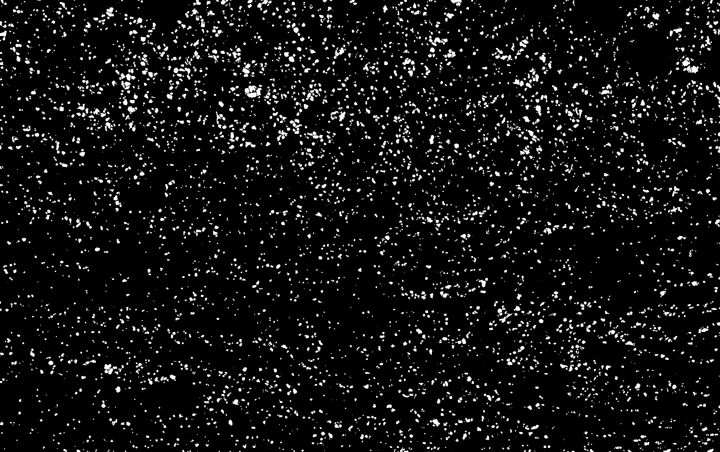
# | 1 | 2 | 3 | 4 | 5
Density(mm⁻²) | 5329 | 7675 | 5971 | 5340 | 6282
% | 53% | 77% | 60% | 53% | 63%
5
4
3
2
1

Slide 9
p3

Slide 10

# | 1 | 2 | 3 | 4 | 5 | 6
Density(mm⁻²) | 1072 | 1337 | 607 | 784 | 874 | 983
% | 11% | 13% | 6.1% | 7.8% | 8.7% | 9.8%
6
4
3
2
5
1

Slide 12
p4

Slide 13
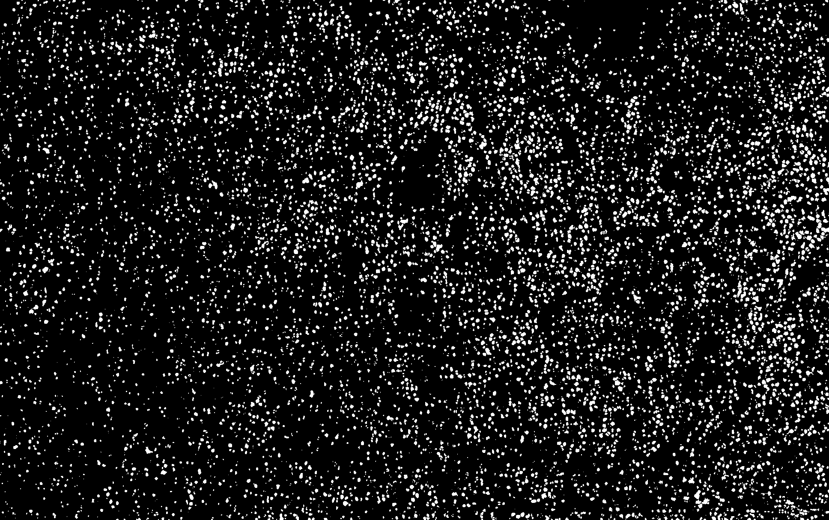
# | 1 | 2 | 3 | 4 | 5
Density(mm⁻²) | 9722 | 5422 | 5522 | 10932 | 6112
% | 97% | 54% | 55% | 109% | 61%
5
4
3
2
1
4

Slide 15
Comparison

Slide 16
p6
Old dye (4/23) – tested 5/8/2019

Slide 17





Slide 19
p6
New dye (5/6)

Slide 20



Dirty top mirror

Slide 21
Cleaned top mirror

Slide 22
p7

Slide 25
p8

Slide 28
Last time…

Slide 29
P1

Slide 31
P2

Slide 33
p6

Slide 35
p8

